Slide 1




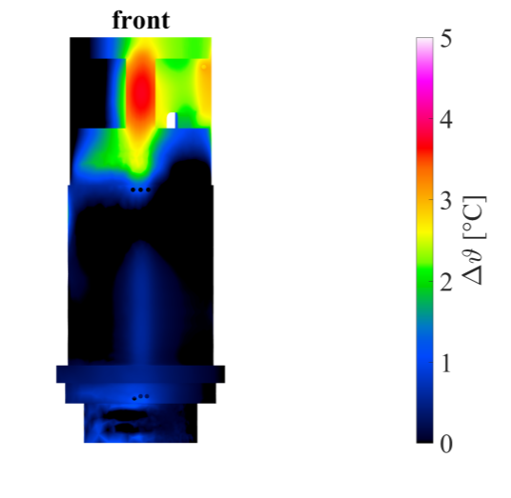
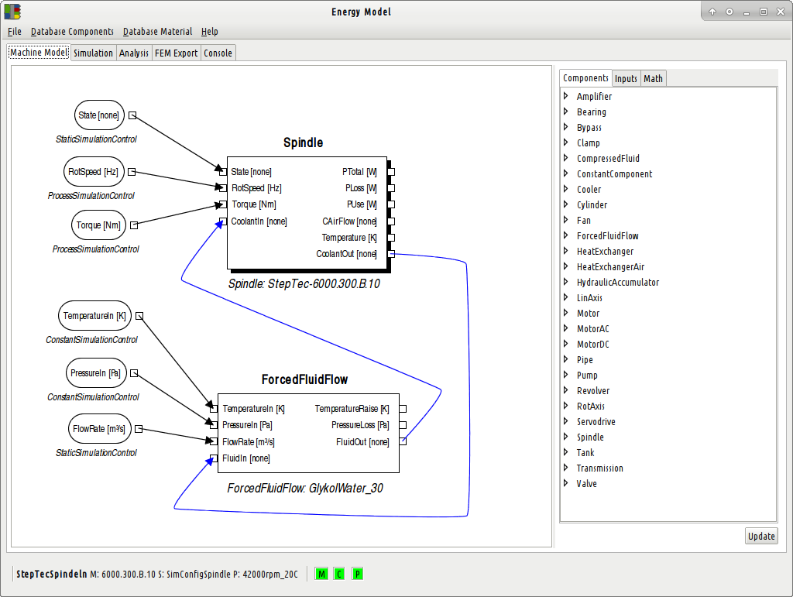
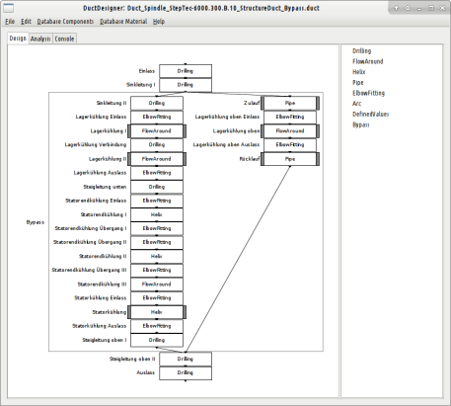
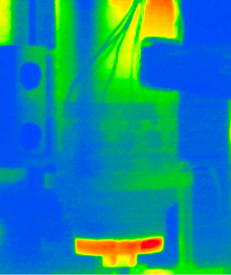
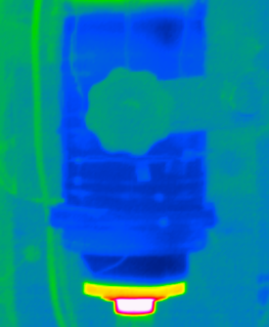

Anwendungsbeispiel: Bearbeitungsspindel
Identification of heat sources
Design concept and optimization
Virtual prototype
Physical Prototype
Electric drive, air gap friction, bearings
macro models
cooling demand, boundary conditions
evaluation of cooling concepts and duct routings
CFD Simulation
Verification of the concept
based on the identified boundary conditions
Test field
Thermo-couples, thermographic imaging
Verification of the performance
based on the developed software DuctDesigner.
vorher
optimiert
S. Züst, F. Pavliček, L. Fischer, L. Weiss, K. Wegener, Thermo-Energetic Modelling of Machine Tool Spindles with Active Cooling based on Macro Models, International Journal for Mechatronics and Manufacturing Systems, 9(3): 197-21.
S. Züst, F. Pavliček, L. Fischer, L. Weiss, K. Wegener, Macro-Models for Modelling and Simulation of Cooled Spindles, Special Interest Group Meeting: Thermal Issues, 17 - 18 March 2016, 2016, Prague, CZ.

